Slide 1
Optimizing Scanning Filters For Color Balanced Multispectral Image Recovery
Dinesh Baniya
PSYCH – 221
June 7, 2010

Slide 2
Outline
Motivation
Techniques to estimate Spectra
Wiener Method
Physically Realizable Sensors
Gaussian Sensors
Optimization Procedure
Results
Summary

Slide 3
Motivation
Multispectral imaging systems require filters/sensors
How to choose optimum sensors?
Simulate spectral sensitivity of sensors and their response to spectral information
Add noise, and try to recover the SPD curves from noise-influenced sensor data
If computational models simulate real world phenomena accurately enough, the information will help build an accurate multispectral system

Slide 4
Techniques to Estimate Spectra
Various algorithms allow estimation of spectral information from sensor responses
Maloney–Wandell method
Imai–Berns method
Shi–Healey method
Wiener method
These methods are based on a priori knowledge of spectra to be recovered

Slide 5
Wiener Method
Given a multispectral image (x)
y = Ax + n
A = Illuminant SPD * Sensor SPD
n = Photon noise
Estimated spectra (x’)
x’ = W * y
W = (R_{xx} * A^{T}) * (A * R_{xx} * A^{T} + V_{N})⁻¹
R_{xx} = Autocorrelation of (x)
V_{N} = Variance of noise

Slide 6
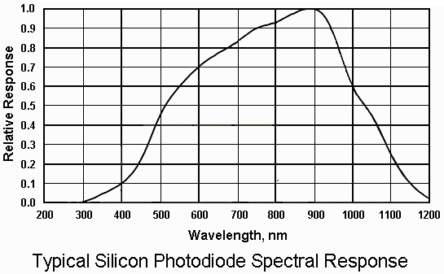
Physically Realizable Sensors
Smooth and nonnegative - Gaussian, Raised Cosines
Sensor SPD limited by Silicon SPD

Slide 7
Gaussian Sensors
Characterized by mean and standard deviation
Amplitude kept constant
400 nm ≤ μ_{i} ≤ 700 nm
1 nm ≤ σ_{i} ≤ 100 nm

Slide 8
Optimization Procedure
Algorithm requires minimization of one cost function
Chose cost function to be ΔE_{ab}
Approximates color differences observed by human eye
Used “fmincon” capability of MATLAB
Tried 50 different initial conditions, resulting cost function values were within 5% of each other
Picked filter combination that provided lowest value for cost function

Slide 9
Illuminant and Original Spectra SPD

Slide 10
RESULTS

Slide 11
NikonD100, SNR = 40dB

Slide 12
NikonD100, SNR = 20dB

Slide 13
2 Gaussian Filters, SNR = 40 dB

Slide 14
2 Gaussian Filters, SNR = 20 dB

Slide 15
3 Gaussian Filters, SNR = 40 dB

Slide 16
3 Gaussian Filters, SNR = 20 dB

Slide 17
4 Gaussian Filters, SNR = 40 dB

Slide 18
4 Gaussian Filters, SNR = 20 dB

Slide 19
Sensor Comparison
SNR = 40 dB | Mean ΔE | Minimum ΔE | Maximum ΔE
NikonD100 | 1.0844 | 0.1037 | 5.3974
2 Gaussian Filters | 3.2955 | 0.2654 | 16.8706
3 Gaussian Filters | 0.5113 | 0.1429 | 1.2954
4 Gaussian Filters | 0.3819 | 0.05602 | 1.1033
SNR = 20 dB | Mean ΔE | Minimum ΔE | Maximum ΔE
NikonD100 | 4.5254 | 1.1151 | 15.0848
2 Gaussian Filters | 4.1101 | 0.5136 | 17.6832
3 Gaussian Filters | 2.7405 | 0.4282 | 7.8050
4 Gaussian Filters | 2.3601 | 0.5223 | 8.3124

Slide 20
Summary
Wiener method used to estimate spectra
Gaussian sensors were created and optimized based upon cost function ΔE
Performance of 2,3,4 Gaussian sensors were compared against NikonD100 sensor
Increasing the number of sensors decreased the mean of ΔE when SNR is high
Wiener method fails when SNR is low

Slide 21
Acknowledgments
Professor Brian Wandell
Teaching basics of color and vision systems
Dr. Joyce Farrell
Project Formulation/Counseling
Multispectral data collection arrangement with Intuitive Surgical
Steven Lansel
Project guidance
Multispectral data collection at Intuitive Surgical
Weekly meetings
MATLAB help
Jeff DiCarlo
Contact person at Intuitive Surgical
Multispectral data collection at Intuitive Surgical

Slide 22
References
[1] Miguel Lopez-Alvarez, et.al “Selecting algorithms, sensors, and linear bases for optimum spectral recovery of skylight”, JOSAA, Vol. 24, Issue 4, 2007
[2] Miguel Lopez-Alvarez, et.al, “Designing a practical system for spectral imaging of skylight”, Applied Optics, Vol. 44, No. 27, 2005
[3] Manu Parmar and Stanley Reeves, “Optimization of Color Filter Sensitivity Functions for Color Filter Array Based Image Acquisition”, 2006
[4] Poorvi L. Vora and H. Joel Trussell, “Mathematical Methods for the Design of Color Scanning Filters”, IEEE Transactions on Image Processing, Vol. 6, No. 2, 1997

Slide 23
Q & A
THANK YOU

