Slide 1
Stereo Imaging
Stereo Imaging
Using 2-D Images to Create 3-D Perceptions
AJ Minich
Psych 221, Winter 2008
Final Project
March 18, 2008

Slide 2
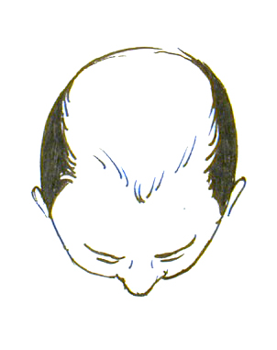
Stereograms
The art of tricking your two eyes into perceiving depth in a two-dimensional image
Left eye
Right eye
Left eye view
Right eye view

Slide 3
The Problem
2-dimensional images don’t do that
Left eye
Right eye
Left eye view
Right eye view

Slide 4
Two different images
Trick your eyes into interpreting different images as one
Left eye
Right eye
Left eye view
Right eye view

Slide 5
Method 1: Separated Images
Actually present two different images to the eyes
Left eye
Right eye
Left eye view
Right eye view
Notes:
Unfortunately, this is not the best method because the eyes are used to converging on a specific image, but here they are both looking straight forward.

Slide 6


Method 1: Separated Images
Left eye view
Right eye view
Notes:
Benefits: color, high fidelity
Drawbacks: uncomfortable for eyes to look straight ahead; requires vision separation

Slide 7
Method 2: Anaglyphs
Use colored glasses to receive different visuals
Left eye
Right eye
Left eye view
Right eye view

Slide 8







Method 2: Anaglyphs
Left eye view
Right eye view

Slide 9
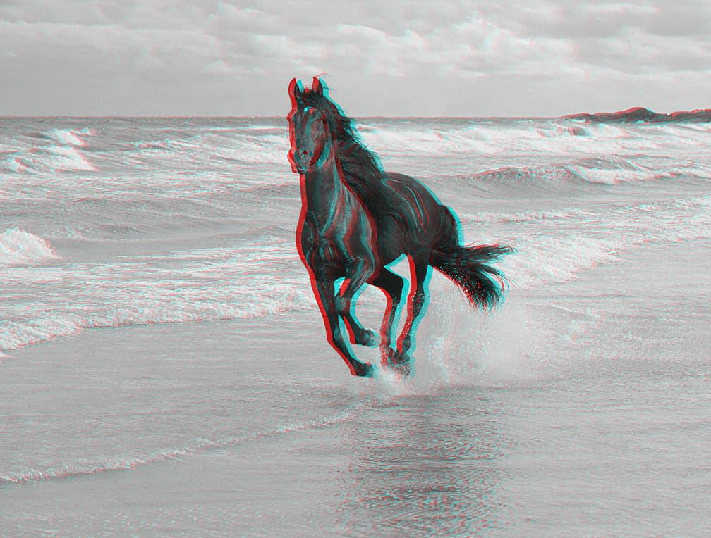
Method 2: Anaglyphs
Notes:
Works well on images with sharp foregrounds and rougher, undefined backgrounds

Slide 10

Method 2: Anaglyphs
Notes:
Not too good with images where there’s a lot of stuff going on

Slide 11

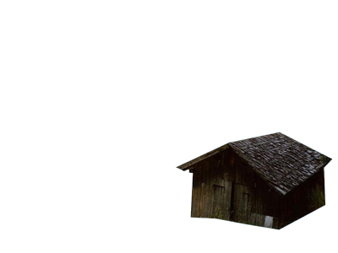
Method 2: Anaglyphs
Background
Image

Slide 12

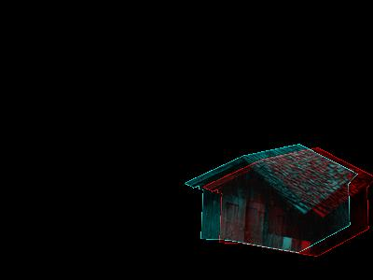
Method 2: Anaglyphs
Background
Image

Slide 13
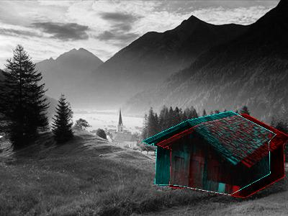
Method 2: Anaglyphs

Slide 14

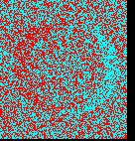
Random Dot Stereogram

Slide 15
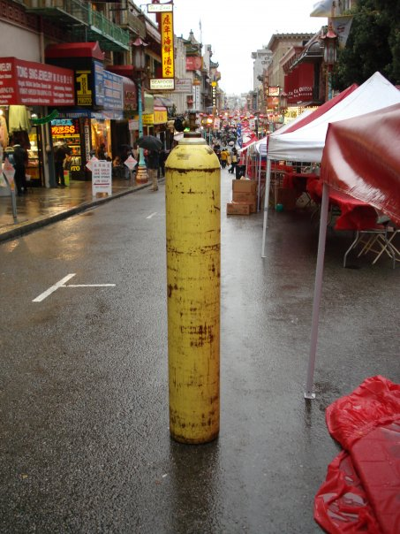
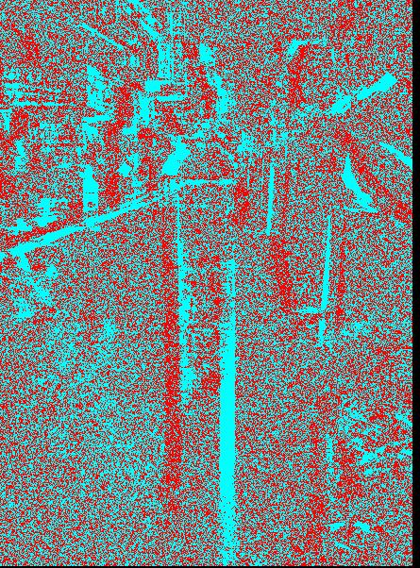
Random Dot Stereogram

Slide 16
The Future
Use a pair of glasses with dimmable lenses to control which eye is seeing the current image?
Textured monitors/displays?
Holographic displays to represent visual information in true 3D
The world of 3D display is opening up, and we will see many exciting applications in the near future.

